Slide 1
Controlled Substances (CS) New Mandates, including use of CS in Treating Pain
AB 474 – effective Jan. 1, 2018
Weldon (Don) Havins, MD, JD, LLM (Health Law)
Professor and Director of Medical Jurisprudence
Touro University Nevada
Joseph P Hardy, MD
Associate Professor of Primary Care
Touro University Nevada

Slide 2
DISCLOSURES
NO CONFLICTS TO DISCLOSE
Joe Hardy, MD
Weldon (Don) Havins, MD, JD
wehavins.com
All course materials may be downloaded from this website

Slide 3
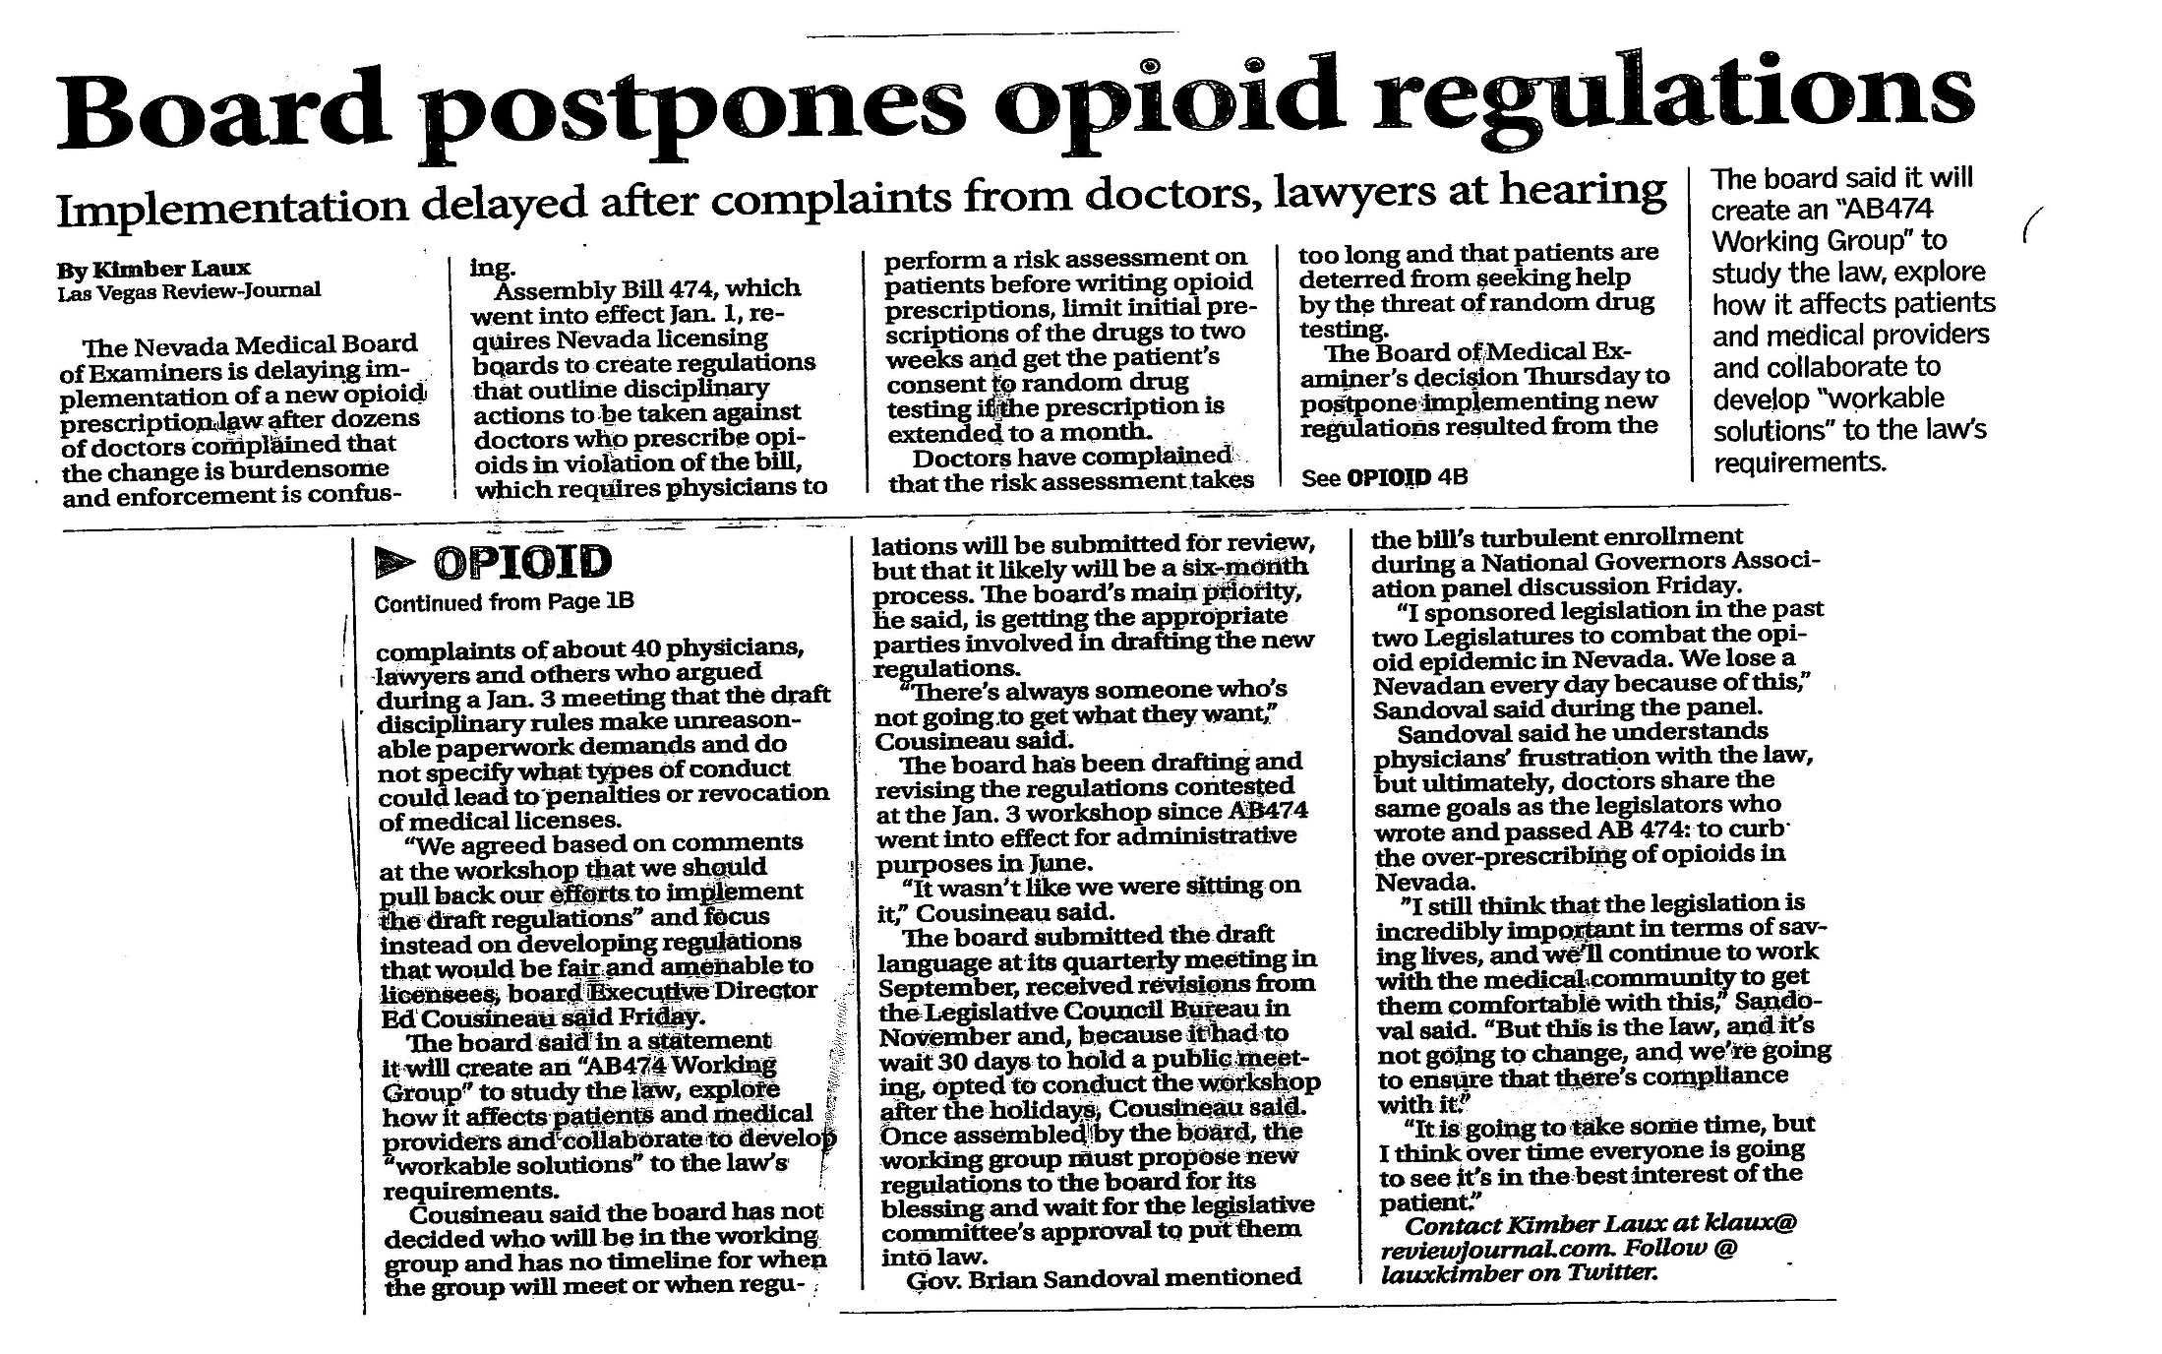
Review Journal Article, Saturday, Jan 13, 2018

Slide 4
AB 474 of 2017 – Sec. 3; NRS 441A.150 effective Jan 1, 2018
Cases of drug overdose or suspected overdose must be reported to the Chief Medical Officer by the provider of health care who knows of, or provided services to, the person.
Any provider who willfully fails, neglects or refuses to comply is guilty of a misdemeanor and may be subject to an administrative fine of $ 1000 for each violation, as determined by the Board of Health.

Slide 5
Board of Health regulation R053-18A
“Discharge” means the physical release of a patient, regardless of whether the patient is alive, from a medical facility or from the care of a provider of health care to any other place, including, without limitation, the home of the patient, a transitional medical facility, a treatment center, the office of a coroner or a funeral home.
“Drug overdose” means any intentional or accidental consumption of a controlled substance listed in schedule I, II, III, IV or V in an amount that exceeds the amount prescribed or intended to be consumed that:
1. Results in a patient receiving services from a provider of health care in a clinical setting; and
2. Corresponds to the code T40, T41.1, T42 or T43

Slide 6
BOH Reg R053-18A
A provider of health care who provides services to a patient who has suffered or is suspected of having suffered a drug overdose shall, regardless of whether the patient is alive and not later than 7 days after discharging the patient, report the drug overdose or suspected drug overdose to the Chief Medical Officer or his or her designee.
A provider of health care who provides outpatient services to a patient whom the provider of health care reasonably believes previously suffered or is suspected of having suffered a drug overdose is not required to make a report of the drug overdose unless the provider of health care believes that such a report was not made by any other provider of health care; if so, 7 days to report.

Slide 7
BOH Reg R053-18A
No report required by provider of health care if the patient who has suffered or is suspected of having suffered the drug overdose was receiving hospice care or palliative care at the time of the drug overdose or suspected drug overdose.

Slide 8
BOH Reg. R053-18A
Report of the overdose must include, if known:
(a) The name, address and telephone number of the provider of health care making the report;
(b) The name, address, telephone number, sex, race, ethnicity and date of birth of the patient who suffered the drug overdose or suspected drug overdose;
(c) The number assigned to the medical record of the patient;
(d) The date on which the drug overdose or suspected drug overdose occurred;
(e) A statement of the disposition of the patient;
(f) ICD 10 code relating to the overdose or suspected overdose

Slide 9
BOH Reg. R053-18A
If the facility has more than one provider who provides care to the patient, the facility shall develop administrative procedures to ensure that only one provider reports.
The Chief Administrative Officer shall develop a system to record such reports.

Slide 10
Nevada Chief Medical Officer address – not in AB474
Nevada State Chief Medical Officer
Nevada Department of Health and Human Services
4150 Technology Way
Carson City, NV 89706
775-684-4200

Slide 11
AB 474 of 2017 – Sec. 13, NRS 629.061 effective Jan 1, 2018 – Medical Record (MR) production
Law enforcement or board investigator declaring “exigent circumstances” requires provider’s immediate production of medical records (at the time of the request); if MRs are out of State, 5 days. (Sec. 13)
Regular production of MRs by the custodian of MRs is 10 days (20 days if out of State).
See SB 291 (2017)

Slide 12
AB 474 of 2017 – all 6 Boards effective Jan 1, 2018 – NRS 630.2535; NRS 631.344; NRS 632.2375; NRS 633.473; NRS 635.116; NRS 636.2881
Each (of the six) Board shall, by regulation, require each practitioner certified or registered to dispense CS to complete 2 hours of training relating to the misuse and abuse of CS, the prescribing of opioids or addiction during each relicensure period.
These CMEs may be used to satisfy 2 hours of any continuing education requirement.
(FYI, AB 105, effective July 1, 2017, requires 2 CME hours every four (4) years in suicide prevention.)

Slide 13
NBOM Regulation R116-17A
NAC 633.250:
Each osteopathic physician and PA, for licensure renewal, must attest he or she has completed 2 hours continuing education related to misuse and abuse of CS, the prescribing of opioids or addiction.
Each osteopathic physician shall complete 2 hours instruction on evidence-based suicide prevention and awareness every 4 years.

Slide 14
NBME Existing Mandate to Report Violations
NRS 630.3062 The following acts, among others, constitute grounds for initiating disciplinary action or denying licensure:
6. Failure to report any person the licensee knows, or has reason to know, is in violation of the provisions of this chapter or the regulations of the Board within 30 days after the date the licensee knows or has reason to know of the violation.
NRS 630.3062 The following acts, among others, constitute grounds for initiating disciplinary action or denying licensure:
3. Making or filing a report which the licensee knows to be false, failing to file a record or report as required by law or knowingly or willfully obstructing or inducing another to obstruct such filing.

Slide 15
NBOM Existing Mandate to Report Violations
NRS 633.511(1) The grounds for initiating disciplinary action pursuant to this chapter are:
(p) Failure to report any person the licensee knows, or has reason to know, is in violation of the provisions of this chapter or the regulations of the Board within 30 days after the date the licensee knows or has reason to know of the violation.
(o) Making or filing a report which the licensee knows to be false, failing to file a record or report that is required by law or knowingly or willfully obstructing or inducing another to obstruct the making or filing of such a record or report.

Slide 16
Controlled Substances
Drugs and other substances that are considered controlled substances under the Controlled Substances Act (CSA) are divided into five schedules.
Substances are placed in their respective schedules based on whether they have a currently accepted medical use in treatment in the United States, their relative abuse potential, and likelihood of causing dependence when abused.

Slide 17
Schedule II - Controlled Substances
Substances in this schedule have a high potential for abuse which may lead to severe psychological or physical dependence.
Examples of Schedule II narcotics include: hydromorphone (Dilaudid®), methadone (Dolophine®), meperidine (Demerol®), oxycodone (OxyContin®, Percocet®), and fentanyl (Sublimaze®, Duragesic®). Other Schedule II narcotics include: morphine, opium, codeine, and hydrocodone.
Examples of Schedule IIN stimulants include: amphetamine (Dexedrine®, Adderall®), methamphetamine (Desoxyn®), and methylphenidate (Ritalin®)
Other Schedule II substances include: amobarbital, glutethimide, and pentobarbital.

Slide 18
Schedule III - Controlled Substances
Substances in this schedule have a potential for abuse less than substances in Schedules I or II and abuse may lead to moderate or low physical dependence or high psychological dependence.
Examples of Schedule III narcotics include: products containing not more than 90 milligrams of codeine per dosage unit (Tylenol with Codeine®), and buprenorphine (Suboxone®).
Examples of Schedule IIIN non-narcotics include: benzphetamine (Didrex®), phendimetrazine, ketamine, and anabolic steroids such as Depo®-Testosterone.

Slide 19
Schedule IV - Controlled Substances
Substances in this schedule have a low potential for abuse relative to substances in Schedule III.
Examples of Schedule IV substances include: alprazolam (Xanax®), carisoprodol (Soma®), clonazepam (Klonopin®), clorazepate (Tranxene®), diazepam (Valium®), lorazepam (Ativan®), midazolam (Versed®), temazepam (Restoril®), and triazolam (Halcion®).

Slide 20
AB 474 of 2017 effective Jan 1, 2018 – Sec 57; NRS 639.23915
Before prescribing a CS (II, III, IV), a practitioner must consider the following factors, when applicable:
Whether there is reason to believe that the patient is not using the CS as prescribed or is diverting the CS for use by another person.
Whether the CS has had the expected effect on the symptoms of the patient.
Whether there is reason to believe that the patient is using other drugs, including alcohol, Schedule I CS or prescription drugs that:
  May interact negatively with the CS prescribed; or
  Have not been prescribed by a practitioner who is treating the patient.

Slide 21
AB 474 of 2017 effective Jan 1, 2018 – Sec 57; NRS 639.23915
Before prescribing a CS (II, III, IV), a practitioner must consider the following factors, when applicable:
4. The number of attempts by the patient to obtain an early refill of the prescription.
5. The number of times the patient has claimed that the controlled substance has been lost or stolen.
6. Information from the PMP that is irregular or inconsistent or indicates that the patient is inappropriately using a CS.
7. Whether previous blood or urine tests have indicated inappropriate use of CS by the patient.

Slide 22
AB 474 of 2017 effective Jan 1, 2018 – Sec 57; NRS 639.23915
Before prescribing a CS (II, III, IV), a practitioner must consider the following factors, when applicable:
8. The necessity of verifying that CS, other than those authorized under the treatment plan, are not present in the body of the patient.
9. Whether the patient has demonstrated aberrant behavior or intoxication.
10. Whether the patient has increased his or her dose of the CS without authorization by the practitioner.
Whether the patient has been reluctant to stop using the CS or has requested or demanded a CS that is likely to be abused or cause dependency or addiction.
Whether the patient has been reluctant to cooperate with any examination, analysis or test recommended by the practitioner.
13. Whether the patient has a history of substance abuse.

Slide 23
AB 474 of 2017 effective Jan 1, 2018 – Sec 57; NRS 639.23915
Before prescribing a CS (II, III, IV), a practitioner must consider the following factors, when applicable:
14. Any major change in the health of the patient, including, pregnancy, or any diagnosis concerning the mental health of the patient that would affect the medical appropriateness of prescribing the CS for the patient.
15. Any other evidence that the patient is chronically using opioids, misusing, abusing, illegally using or addicted to any drug or failing to comply with the instructions of the practitioner concerning the use of the CS.
16. Any other factor that the practitioner determines is necessary to make an informed professional judgment concerning the medical appropriateness of the prescription.

Slide 24
AB 474 – Sec 60, NRS 639.23507
PMP Mandate – Before prescribing
Practitioner must obtain a PMP utilization report on the patient before issuing an initial prescription for a CS (II, III, IV) and at least every 90 days thereafter.
The practitioner shall:
Review the PMP report to access whether the prescription for the CS is medically necessary, and
Determine whether the patient has been issued another prescription for the same CS for ongoing treatment; if so, the practitioner shall not prescribe the CS.

Slide 25
AB 474 of 2017 effective Jan 1, 2018 Sec. 7; NRS 453.162; NRS 639.2353
Each prescription for Controlled Substances (CS) II, III, and IV must include:
DEA number of the prescriber
ICD 10 diagnosis
Fewest number of days to consume the quantity of CS prescribed; number of refills, and
Each state in which the patient to whom the CS was prescribed has resided or filled a prescription for CS II, III, or IV.
(see AB474 Sec. 7(e)(2); however, this is not required in Sec. 61 of AB474 which amends NRS 639.2353 of the BOP statutes; but, it is required in the prescription medication agreement nevertheless)

Slide 26
Controlled Substance (CS) NOT for Pain
16 considerations before prescribing
Check the PMP (and every 90 days thereafter)
Review the PMP report to access whether the prescription for the CS is medically necessary
Determine whether the patient has been issued another prescription for the same CS for ongoing treatment; if so, the practitioner shall not prescribe the CS
Prescription: ICD 10 Diagnosis code; DEA # is clear; Minimum days to consume at maximum dosage

Slide 27
AB 474 of 2017 effective Jan 1, 2018 – Sec 53; NRS 639.235(4), NRS 639.23911
Before issuing an initial prescription for CS (II, III, IV) for the treatment of pain, a practitioner must:
Have established a bone fide relationship with the patient
(a bona fide relationship between the patient and the person prescribing the controlled substance shall be deemed to exist if the patient was examined in person, electronically, telephonically or by fiber optics, including, without limitation, through telehealth, within or outside this State or the United States by the person prescribing the controlled substances within the 6 months immediately preceding the date the prescription was issued)

Slide 28
AB 474 of 2017 effective Jan 1, 2018 – Sec 53, 54; NRS 639.23911, NRS 639.23912
Before issuing an initial prescription for CS (II, III, IV) for the treatment of pain, a practitioner must:
b. Perform an evaluation and risk assessment which must include:
  Obtaining and reviewing a medical history
  Conducting a physical exam
  Make a good faith effort to obtain and review the MRs from other providers who have provided care to the patient
    practitioner shall document efforts to obtain such MRs
    and the conclusions from reviewing these MRs
  Assess the mental health and risk of abuse, dependency and addiction of the patient
    using methods supported by peer-reviewed scientific research and validated by a nationally recognized organization

Slide 29
AB 474 of 2017
“physical exam” is not limited
  dentists, optometrists, podiatrists
    Not within the scope of practice
Mental health test used at Touro
  Beck’s depression inventory
Test for risk of abuse, dependency and addiction used at Touro
  POMI (Prescription Opioid Misuse Index)

Slide 30
AB 474 of 2017 effective Jan 1, 2018 – Sec 53; NRS 639.23911
Before issuing a prescription for a CS (II, III, IV) for the treatment of pain, a practitioner must:
c. Establish a preliminary diagnosis of the patient and a treatment plan tailored toward treating the pain of the patient and the cause of that pain;
d. Document in the MR the reasons for prescribing the CS instead of an alternative treatment that does not require the use of a CS; and

Slide 31
AB 474 of 2017 effective Jan 1, 2018 Sec 53, 54; NRS 639.239112, NRS 639.23912
Obtain informed consent to use a CS for the treatment of pain from:
  The patient, if the patient is 18 years of age or older or legally emancipated and competent to give such consent;
  The parent or guardian of a patient who is less than 18 years of age and not legally emancipated; or
  The legal guardian of a patient of any age who has been adjudicated mentally incompetent.

Slide 32
AB 474 of 2017 effective Jan 1, 2018 – Sec 53, 54; NRS 639.23911, NRS 639.23912
The informed consent must include information concerning:
potential risks and benefits of treatment using the CS
  including if a form of the CS that is designed to deter abuse is available
  the risks and benefits of using that form
proper use of the controlled substance
any alternative means of treating the symptoms of the patient and the cause of such symptoms
the important provisions of the treatment plan established for the patient

Slide 33
AB 474 of 2017 effective Jan 1, 2018 – Sec 53, 54; NRS 639.23011, NRS 639.23912
The informed consent must include:
5. the risks of dependency, addiction and overdose during treatment using the CS
6. methods to safely store and legally dispose of the CS
7. the manner in which the practitioner will address requests for refills of the prescription
8. if the patient is a woman between 15 and 45
  the risks to a fetus of chronic exposure to CS during pregnancy
  the risks of fetal dependency on the CS and neonatal abstinence syndrome

Slide 34
AB 474 of 2017 effective Jan 1, 2018 Sec 53, 54; NRS 639.23911, NRS 639.23912
The informed consent must include:
9. if the CS is an opioid
  the availability of an opioid antagonist without a prescription, and
  if the patient is an unemancipated minor
    the risks that the minor will abuse or misuse the CS or divert the CS for use by another person, and
    ways to detect such abuse, misuse or diversion

Slide 35
AB 474 of 2017 effective Jan 1, 2018 – Sec 52(2); NRS 639.2391
Pain Treatment with a CS – including an opioid
For treatment of acute pain, shall not prescribe CS for more than 14 days and, if the CS is an opioid, and the patient has never been issued an opioid or it has been more than 19 days since initial prescription for an opioid, prescription may not exceed 90 MMEs per day.

Slide 36
AB 474 of 2017 effective Jan 1, 2018 – Sec 53, 54; NNRS 639.23911, NRS 639.23912
If a practitioner prescribes a CS (II, III, IV) for the treatment of pain, the practitioner shall not issue more than one additional prescription that increases the dose of the CS unless the practitioner meets with the patient, in person or using telehealth, to reevaluate the treatment plan.

Slide 37
Initial Prescription for CS (II, III, IV) for Pain
Same as not for pain, plus:
If acute pain: CS for no more than 14 days; if prescribing an opioid, no more than 90 MMEs if opioid naïve
Bone fide relationship
Evaluation and risk assessment
  Medical history
  Physical exam
  Document good faith effort to obtain and review prior medical records, and document conclusions of review in patient’s MRs

Slide 38
Initial Prescription for CS (II, III, IV) for Pain
  Access mental health and risk of abuse, dependency, and addiction with qualifying tests
Preliminary diagnosis and treatment plan to treat the patient’s pain and the cause of the patient’s pain
Document in the MR the reasons for prescribing the CS instead of an alternative treatment that does not require the use of a CS

Slide 39
Initial Prescription for CS (II, III, IV) for Pain
Obtain an informed consent to use a CS for the treatment of pain from the appropriate authority (person, parent, legal representative)
    The informed consent must include the eight (8) required elements, plus, if an opiate, four (4) additional elements.
No more than one increase in the CS unless re-evaluation of treatment plan in-person or telehealth

Slide 40
AB 474 of 2017 effective Jan 1, 2018 – Sec 56; NRS 639.23914
Pain Treatment using a CS for > 30 days
If a practitioner intends to prescribe a controlled substance (II, III, IV) for more than 30 days for the treatment of pain, the practitioner must, not later than 30 days after issuing the initial prescription, enter into a prescription medication agreement with the patient, which must be:
Documented in the patient’s MRs; and updated at least once every 365 days while the patient is using the CS, or updated whenever a change is made to the treatment plan.

Slide 41
AB 474 of 2017 effective Jan 1, 2018 – Sec 56; NRS 639.23914
Pain Treatment using a CS for > 30 days
A prescription medication agreement must include:
The goals of the treatment of the patient
Consent of the patient to testing to monitor drug use when deemed medically necessary by the practitioner;
A requirement that the patient take the CS only as prescribed;
A prohibition on sharing medication with any other person;

Slide 42
AB 474 of 2017 effective Jan 1, 2018 – Sec 56
Pain Treatment using a CS > 30 days
A prescription medication agreement must include:
e. A requirement that the patient inform the practitioner:
Of any other CS prescribed to or taken by the patient;
Whether the patient drinks alcohol or uses marijuana or any other cannabinoid while using the CS
Whether the patient has been treated for side effects or complications relating to the use of the CS, including whether the patient has experienced an overdose; and
Each state in which the patient has previously resided or had a prescription for a CS filled;

Slide 43
AB 474 of 2017 effective Jan 1, 2018 – Sec 56
Pain Treatment using a CS > 30 days
A prescription medication agreement must include:
f. Authorization for the practitioner to conduct random counts of the amount of the CS in the possession of the patient;
g. The reason the practitioner may change or discontinue treatment of the patient using the CS; and
h. Any other requirements that the practitioner may impose.

Slide 44
Using a CS for the treatment of pain for >30 days
Prescription Medication Agreement
  must contain all 10 elements (plus any additional desired by the practitioner)
  must be renewed every 365 days, and updated after any change in the treatment plan

Slide 45
AB 474 of 2017 effective Jan 1, 2018 – Sec 55; NRS 639.23913
Pain Treatment using a CS > 90 days
Before prescribing a CS (II, III, IV) to continue to treat pain for 90 days or more, a practitioner must:
Require the patient to complete an assessment of the patient’s risk for abuse, dependency and addiction that has been validated through peer-reviewed scientific research;
Conduct an investigation, including appropriate hematological and radiological studies, to determine an evidence-based diagnosis for the cause of the pain;

Slide 46
AB 474 of 2017 effective Jan 1, 2018 – Sec 55;p NRS 639.23913
Pain Treatment using a CS > 90 days
Before prescribing a CS (II, III, IV) to continue to treat pain for 90 days or more, a practitioner must:
Meet with the patient, in person or using telehealth, to review the treatment plan to determine whether continuation of treatment using the CS is medically appropriate; and
If the patient has been prescribed a dose of 90 MMEs or more of an opioid per day for 90 days or longer, consider referring the patient to a specialist

Slide 47
AB 474 of 2017 effective Jan 1, 2018 – Sec 52, NRS 639.2391
Pain Treatment using a CS
If practitioner prescribes more than 365 days of CS pain medication (II, III, IV) in 365 days, practitioner must document in MR the reasons, or
for a larger quantity of CS (II, III, IV) than will be used in 90 days, the prescriber must document in the MR the reasons.

Slide 48
AB 474 of 2017 effective Jan 1, 2018 – Sec 55; NRS 639.23913
Pain Treatment using an opioid
If the practitioner decides to continue to prescribe a dose of 90 MMEs or greater per day, the practitioner must develop and document in the patient’s MRs a revised treatment plan with must include an assessment of the increased risk for adverse outcomes.

Slide 49
Using a CS (II, III, IV) for the treatment of Pain
90 days
complete another assessment for the patient’s risk of abuse, dependency, or addiction (COMM test)
conduct an investigation to determine an evidenced-based diagnosis for the cause of the pain
meet with patient, in-person or telehealth, to determine whether continuation with a CS for the treatment of pain is medically appropriate
if patient is on a dose of 90 MMEs or greater, consider referring to a specialist
if continuing 90 MMEs or >, document in MR the revised treatment plan, including risk for adverse outcomes

Slide 50
AB 474 of 2017 effective Jan 1, 2018 – Sec 9; NRS 453.164
Board of Pharmacy (BOP) may access the PMP to identify any suspected fraudulent, illegal, unauthorized activity related to prescribing, dispensing, or use of a CS.
Discovered information shall be reported to law enforcement or licensing board.
Dispensing Licensees must present proof of authorization to access the PMP to be relicensed.

Slide 51
AB 474 of 2017 effective Jan 1, 2018
Sec. 15, NRS 630.323; Sec. 22, NRS 631.364; Sec. 28, NRS 632.352;
Sec. 33, NRS 633.574; Sec. 40, NRS 635.152; Sec. 45; NRS 636.338
Failure to comply with requirements of NRS 453.163, 453.164, 639.23507, and sections 52 to 58 of AB 474, and any regulations adopted by the BOP, subjects the licensee to licensure discipline.
Fraudulent, illegal, unauthorized or otherwise inappropriate prescribing, administering or dispensing of a CS subjects the licensee to licensure discipline.

Slide 52
AB 474 of 2017 effective Jan 1, 2018
Sec. 15, NRS 630.323; Sec. 22, NRS 631.364; Sec. 28, NRS 632.352;
Sec. 33, NRS 633.574; Sec. 40, NRS 635.152; Sec. 45; NRS 636.338
If licensing Board Executive Director (ED) receives complaint from law enforcement, BOP, or any other source, that the licensee has:
has issued a fraudulent, illegal, unauthorized or inappropriate CS prescription, or
a pattern of such prescribing, or
a patient (of the licensee) who has acquired, used or possessed a CS (II thru IV) as above, then:

Slide 53
AB 474 of 2017 – all 6 Boards effective Jan 1, 2018 – “review and evaluation”
Sec. 15, NRS 630.323; Sec. 22, NRS 631.364; Sec. 28, NRS 632.352;
Sec. 33, NRS 633.574; Sec. 40, NRS 635.152; Sec. 45; NRS 636.338
ED, or designee, must notify licensee as soon as practicable (may delay notification if criminal investigation ongoing)
ED, or designee, reviews PMP licensee’s information
the licensee is required to attest that licensee has complied with NRS 639.23507 (reviewed patient’s PMP and CS is medically indicated; confirm if ongoing treating CS not written by another prescriber) AND has complied with AB 474 sec. 52, 54, and 57.

Slide 54
AB 474 of 2017 – all 6 Boards, effective Jan 1, 2018
Sec. 15, NRS 630.323; Sec. 22, NRS 631.364; Sec. 28, NRS 632.352;
Sec. 33, NRS 633.574; Sec. 40, NRS 635.152; Sec. 45; NRS 636.338
After “review and evaluation,” if ED, or designee, determines that the licensee may have issued a fraudulent, illegal, unauthorized or inappropriate prescription, the ED, or designee, may refer for criminal prosecution & the Board must proceed as if a written complaint had been filed against the licensee.
After conducting an investigation and a hearing, if licensee is found guilty, the licensing Board must impose appropriate disciplinary action.

Slide 55
AB 474 of 2017 – all 6 Boards, effective Jan 1, 2018
Sec. 15, NRS 630.323; Sec. 22, NRS 631.364; Sec. 28, NRS 632.352;
Sec. 33, NRS 633.574; Sec. 40, NRS 635.152; Sec. 45; NRS 636.338
If the Board determines from investigation that the public health, safety, or welfare, of any patient is at risk of imminent or continued harm, the Board may summarily suspend licensee’s authority to prescribe CS (II, III, IV) pending a determination upon the conclusion of a hearing to consider a formal complaint against the licensee.

Slide 56
AB 474 of 2017 – all 6 Boards, effective Jan 1, 2018
Sec. 15, NRS 630.323; Sec. 22, NRS 631.364; Sec. 28, NRS 632.352;
Sec. 33, NRS 633.574; Sec. 40, NRS 635.152; Sec. 45; NRS 636.338
Such summary suspension may be issued by the Board, President of the Board, presiding officer of an investigative committee (IC) conducting the investigation or member of the Board who conducted the investigation. If IC chair or investigating member issues the summary suspension order, that person may not participate in any further proceedings related to the order.
The licensing Board must hold a hearing and render a decision concerning [whether to file] the formal complaint within 60 days of the summary suspension order for the Medical Board, Nursing Board, Podiatric Board, and Optometric Board, or within 180 days for Osteopathic Medical Board and Dental Board.

Slide 57
AB 474 of 2017 – all 6 Boards, effective Jan 1, 2018
Sec. 15, NRS 630.323; Sec. 22, NRS 631.364; Sec. 28, NRS 632.352;
Sec. 33, NRS 633.574; Sec. 40, NRS 635.152; Sec. 45; NRS 636.338
The licensing Board shall adopt regulations providing for disciplinary action against a licensee for inappropriately prescribing a CS (II, III, IV) or violation of Section 52 to 58 of AB 474, and any regulations of the BOP, to include additional continuing education concerning prescribing CS II, III, IV.

Slide 58
AB 474 of 2017 effective Jan 1, 2018 – Sec 58; NRS 630.23916
The BOP may adopt any regulations necessary or convenient to enforce the provisions of NRS 639.23507, and Sections 52 to 58 of AB 474. Such regulations may impose additional requirements concerning the prescription of CS II, III, IV for the treatment of pain.
A practitioner who violates any provision of this act or any furthering regulations is:
Not guilty of a misdemeanor; and [is]
Subject to professional discipline.

Slide 59
Controlled Substance (CS) NOT for Pain
16 considerations before prescribing
Check the PMP (and every 90 days thereafter)
Review the PMP report to access whether the prescription for the CS is medically necessary
Determine whether the patient has been issued another prescription for the same CS for ongoing treatment; if so, the practitioner shall not prescribe the CS
Prescription: ICD 10 Diagnosis code; DEA # is clear; Minimum days to consume at maximum dosage

Slide 60
Initial Prescription for CS (II, III, IV) for Pain
Same as not for pain, plus:
If acute pain: CS for no more than 14 days; if prescribing an opioid, no more than 90 MMEs if opioid naïve
Bone fide relationship
Evaluation and risk assessment
  Medical history
  Physical exam
  Document good faith effort to obtain and review prior medical records, and document conclusions of review in patient’s MRs

Slide 61
Initial Prescription for CS (II, III, IV) for Pain
  Access mental health and risk of abuse, dependency, and addiction with qualifying tests
Preliminary diagnosis and treatment plan to treat the patient’s pain and the cause of the patient’s pain
Document in the MR the reasons for prescribing the CS instead of an alternative treatment that does not require the use of a CS

Slide 62
Initial Prescription for CS (II, III, IV) for Pain
Obtain an informed consent to use a CS for the treatment of pain from the appropriate authority (person, parent, legal representative)
    The informed consent must include the eight (8) required elements, plus, if an opiate, four (4) additional elements.
No more than one increase in the CS unless re-evaluation of treatment plan in-person or telehealth

Slide 63
Using a CS for the treatment of pain for 30 days
Prescription Medication Agreement
  must contain all 10 elements (plus any additional desired by the practitioner)
  must be renewed every 365 days, and updated after any change in the treatment plan

Slide 64
Using a CS (II, III, IV) for the treatment of Pain
90 days
complete another assessment for the patient’s risk of abuse, dependency, or addiction (COMM test)
conduct an investigation to determine an evidenced-based diagnosis for the cause of the pain
meet with patient, in-person or telehealth, to determine whether continuation with a CS for the treatment of pain is medically appropriate
if patient is on a dose of 90 MMEs or greater, consider referring to a specialist
if continuing 90 MMEs or >, document in MR the revised treatment plan, including risk for adverse outcomes

Slide 65

Thank God He Stopped Talking!!!

Slide 66
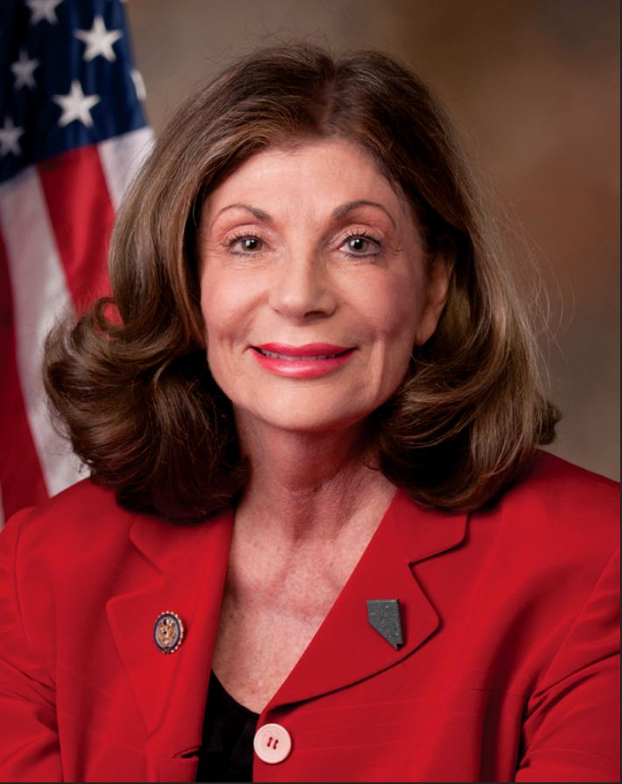
Shelley.Berkley@tun.touro.edu

